Slide 1


Visual Story
Boo at the Zoo
25 oct – 02 Nov

Slide 2

Boo at the Zoo
Activities will run from 10.30am to 3.30pm.
There will be a quiet session at the end of each day, for this there will be no background music or disco lights.
More information on accessible sessions can be found here:
Accessibility and Inclusivity | Zoological Society of London (ZSL)

Slide 3

Weather
This event will be running both indoors and outdoors. When outside it may be wet or cold so you will need a coat, warm clothes and possibly an umbrella and wellies.

Slide 4
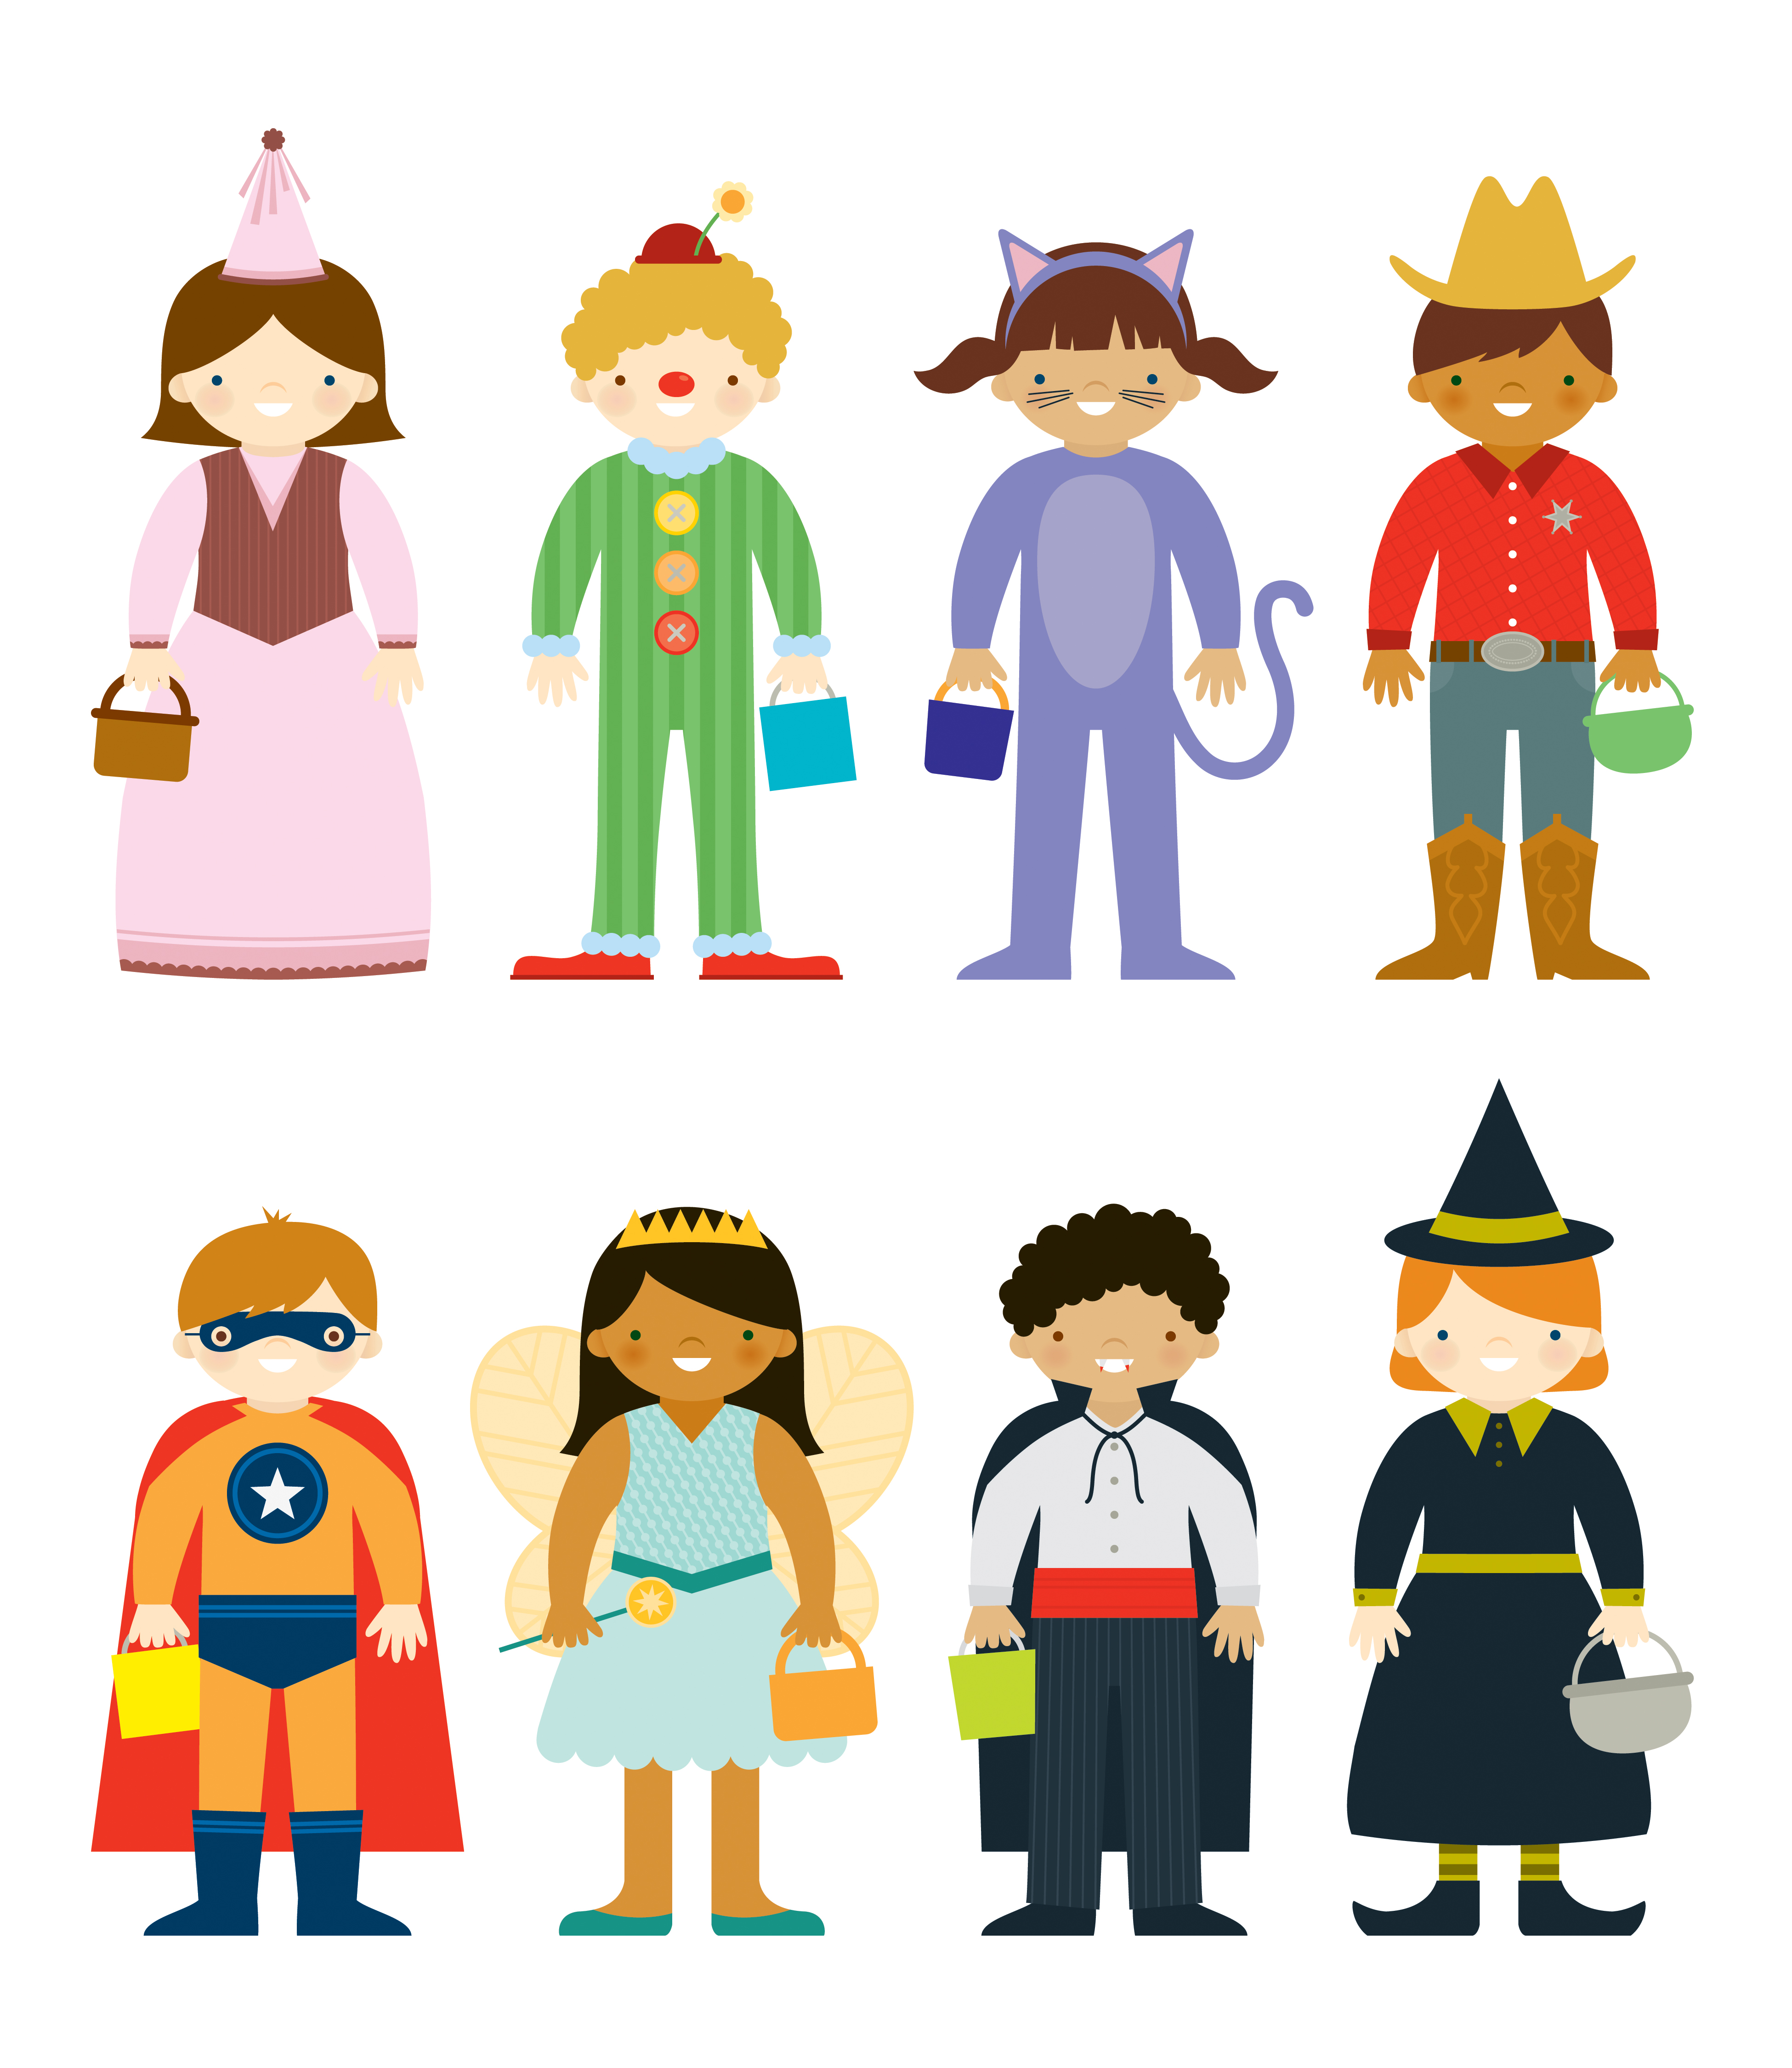
There will be costume contests throughout the day so you may want to wear a Halloween costume.

Slide 5
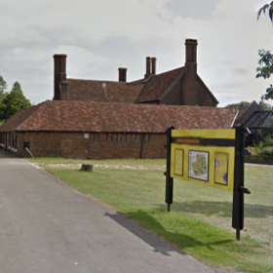
Entering the event
Activities will take place in the learning rooms by butterfly house and aquarium. A map of the Zoo can be downloaded here. You can also download the Zoo app from this page, which may help you with directions onsite.

Slide 6
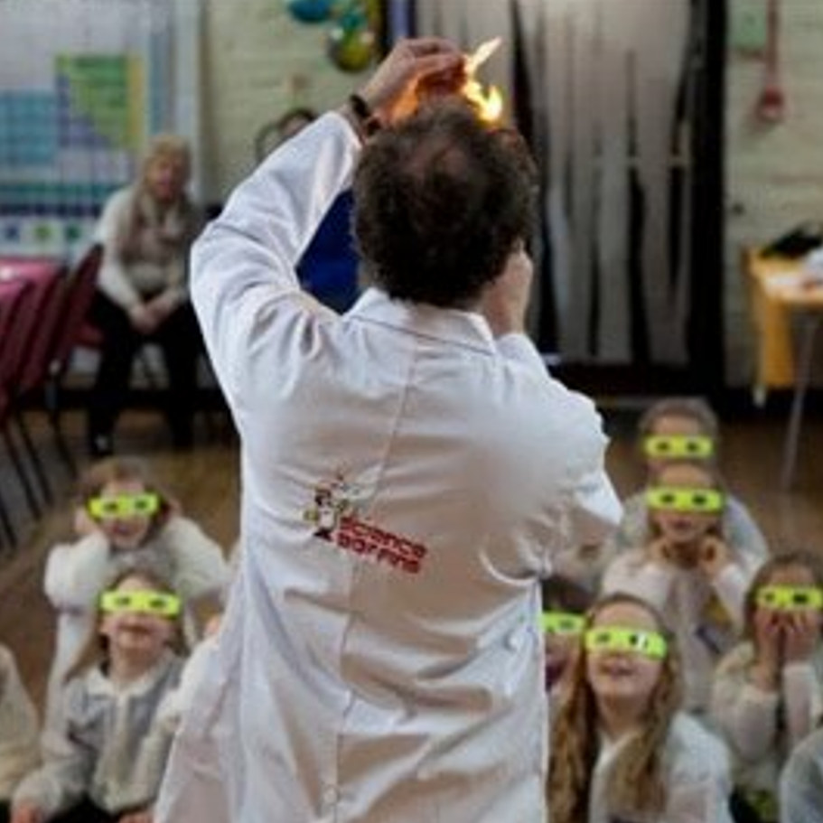
Activities
Science Boffins will be joining us to run some spooky science shows.
The shows will will run at 11am, 11.30, 12pm, 12.30, 1.45pm, and 2.15pm.
There will be a costume contest after the 11am, 12pm and 1.45pm shows.
Please be aware there will be sensory elements to these shows including:
Loud noises
Flashes of light
Strange smells

Slide 7
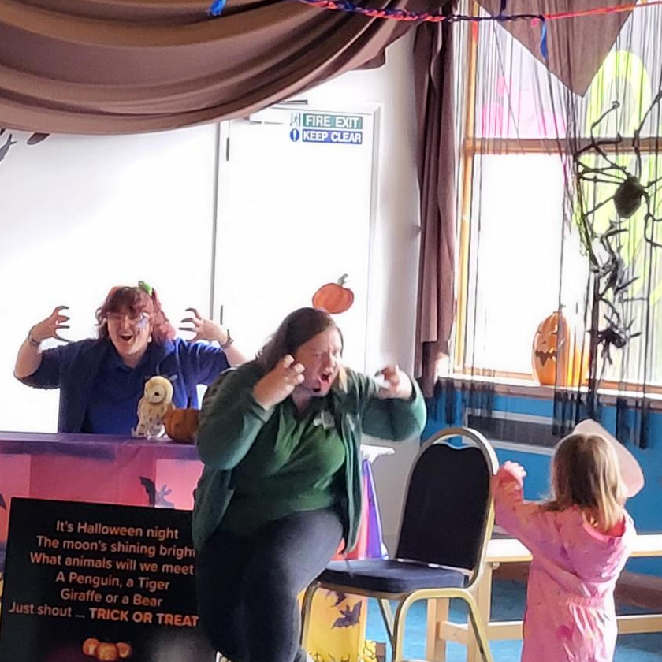
Activities
There are 3 interactive storytelling sessions each day.
The storytellers will use props.
There will be beanbags available for you to sit on.
The stories will run at 10.30am, 1.15pm and 3pm.

Slide 8
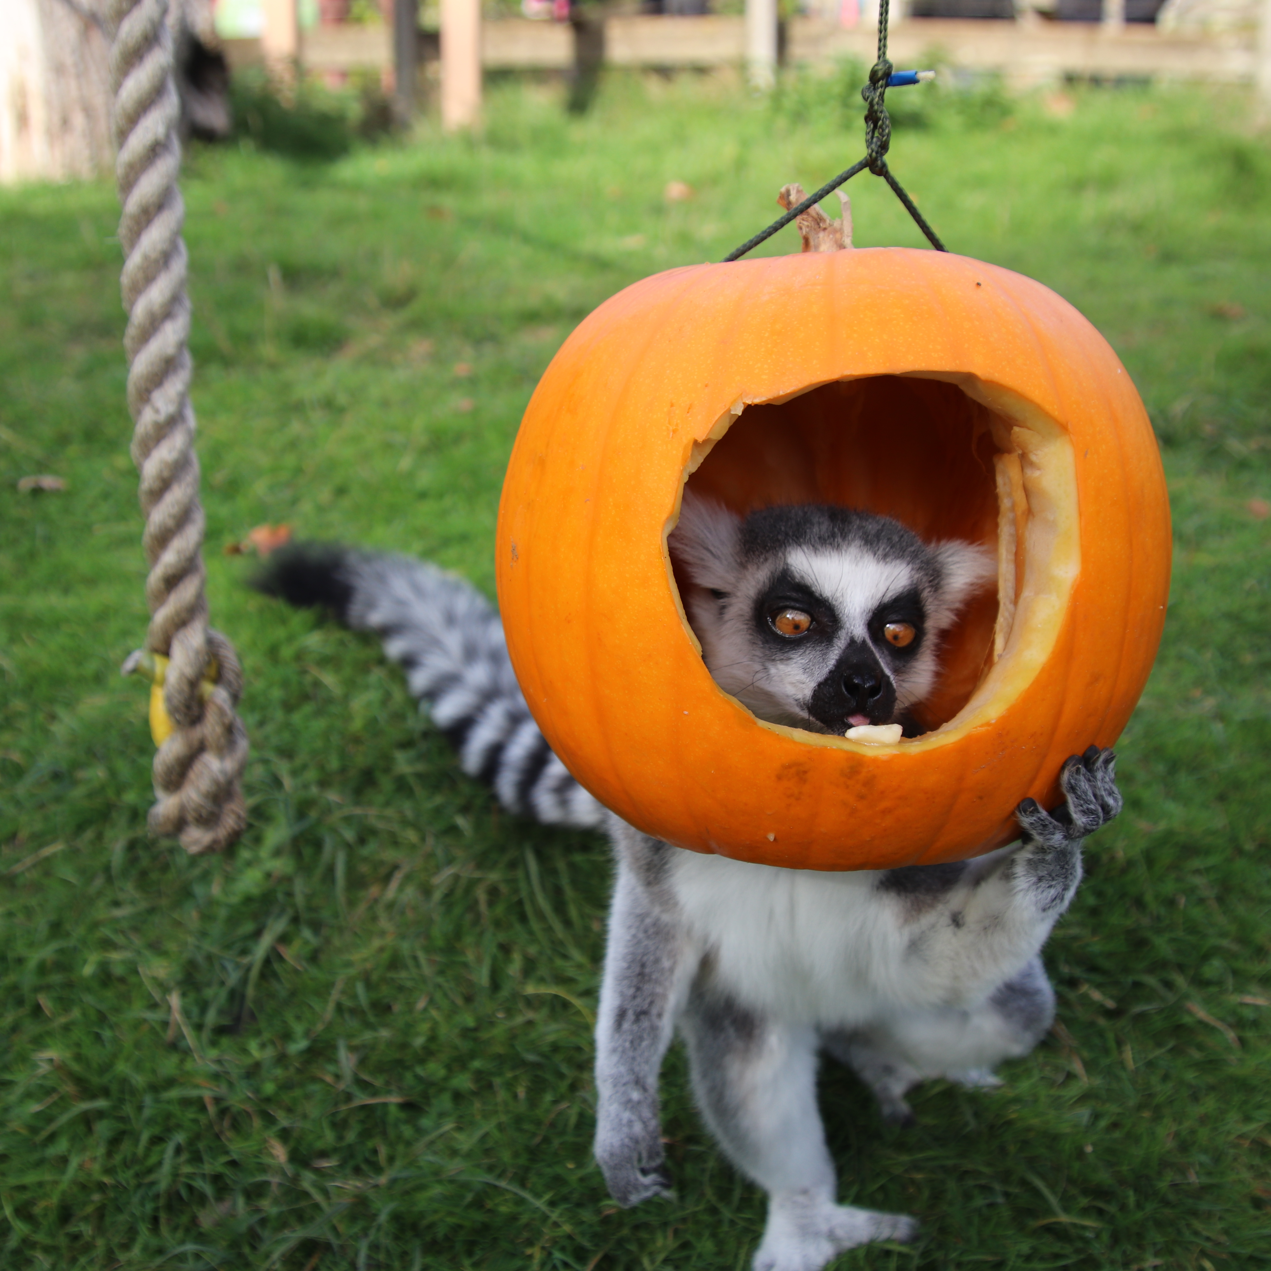
Activities
This is a family friendly tour to learn about the ghosts and history of Whipsnade and how they came to be.
While we have made this activity as family friendly as possible it will contain themes of death and gore.
The tour will run at 11.45pm leave from the picnic shelters by the learning rooms.

Slide 9
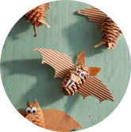
Activities
We will have some creepy crafts for you to help yourself to.
This year we have a few different options to choose from. For example, making animal masks or turning pinecones in bats!
You may need to use scissors, ask a grown up for help.

Slide 10
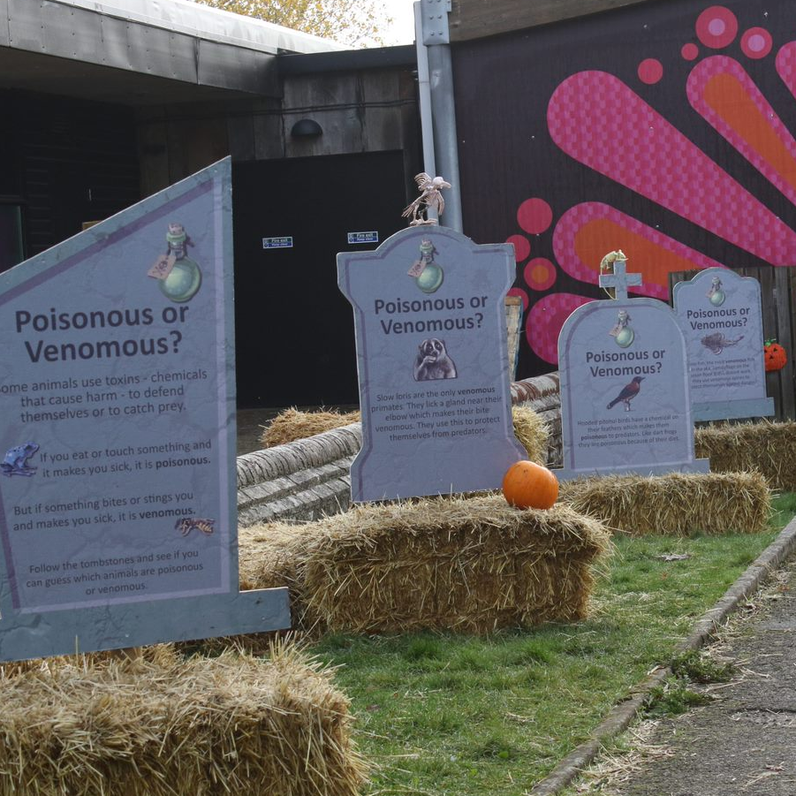
Activities
Brave our graveyard trail.
Each gravestone will have a zoomed in picture of either a bat or a lemur. There will be some facts on the stone too to help you choose the right one.

Slide 11
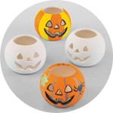
Activities
This year we will have Halloween themed tealight holders that you can decorate for an additional cost.
These will cost £4.50 each, or £8 each.
The pens used for decorating are edible, non-toxic and non-staining.

Slide 12
Considerations
There will be sensory elements to the science show. Ear defenders are available to borrow, please ask a staff member or volunteer.
As the science shows, storytelling, and the creepy crafts are in the same room there may be queueing, and it may be busy.
From 3pm there will be no music or additional lights for our quiet crafting time.

Slide 13
We look forward to welcoming you
this Halloween!
25 oct – 02 Nov

