Slide 1
Vets in Action 2025
A Visual Story

Slide 2
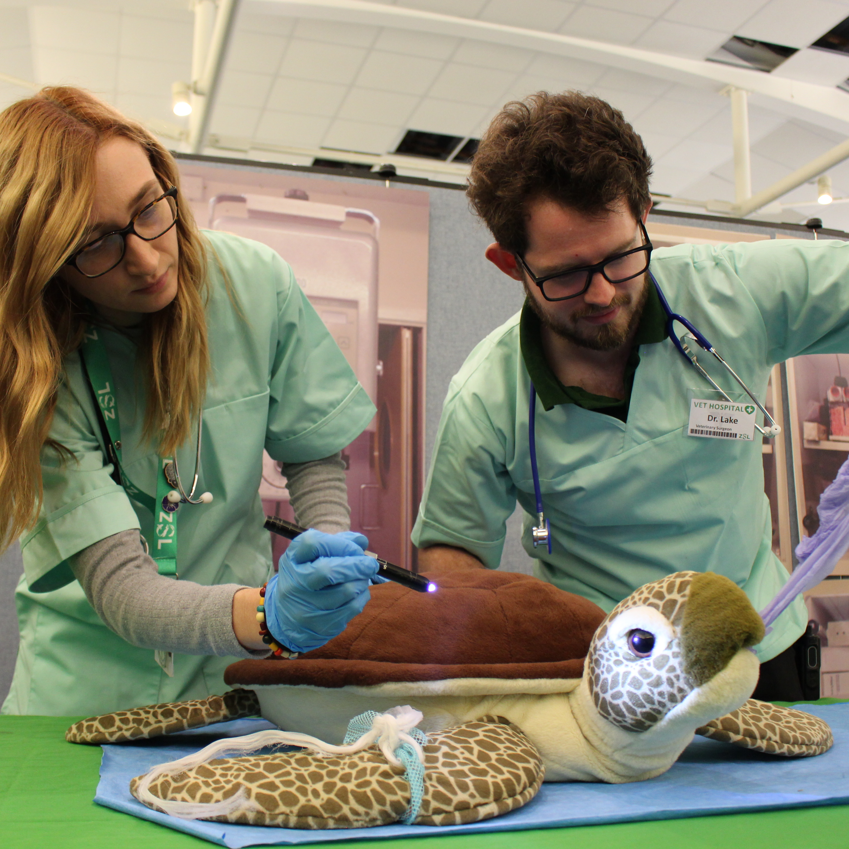
Visitor Information
Vets in Action is a free, indoor event running from the 15th to the 23rd February 2025 at Whipsnade Zoo.
The morning session runs from 10:15 – 12:30 (last entry 12:00)
The afternoon session runs from 1:30 – 3:30 (last entry 3:00)
Gold members, patrons and fellows only session runs from 3:30 – 4:30. (Not on Sunday 23rd)
There will also be a relaxed, quieter opening session on Sunday 23rd February starting at 10:00.
Find out more about the event on our website.
Vets in Action | Whipsnade Zoo

Slide 3
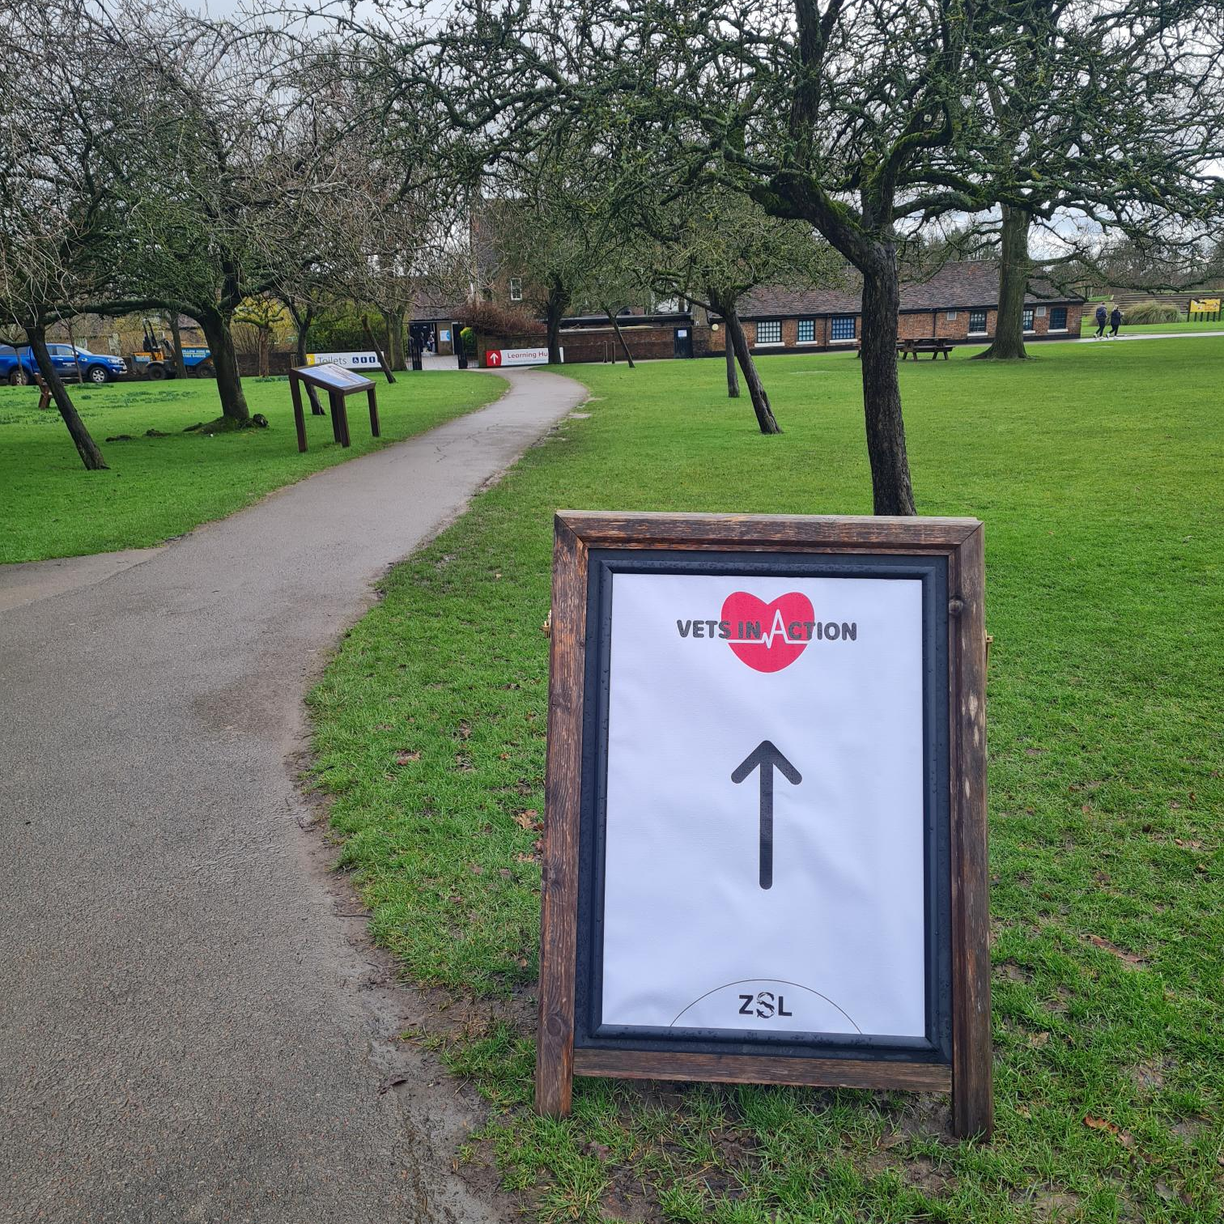
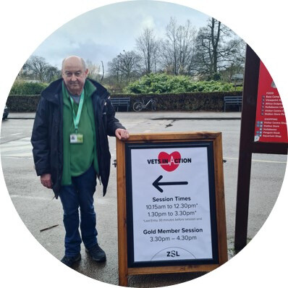
When you arrive at the zoo
If you are arriving on foot, there is signage about the Vets in Action event next to our map when you enter the zoo.
One of our friendly volunteers, who will be wearing a green uniform, may be there to help you if you have any questions.
There are arrows pointing you in the right direction so follow these to the event space where Vets in Action is held.
You will need to cross one zebra crossing and it is a 3-minute walk from the entrance.
If you are arriving by car, turn left and head to the nearest car park which is Hullabazoo car park.

Slide 4
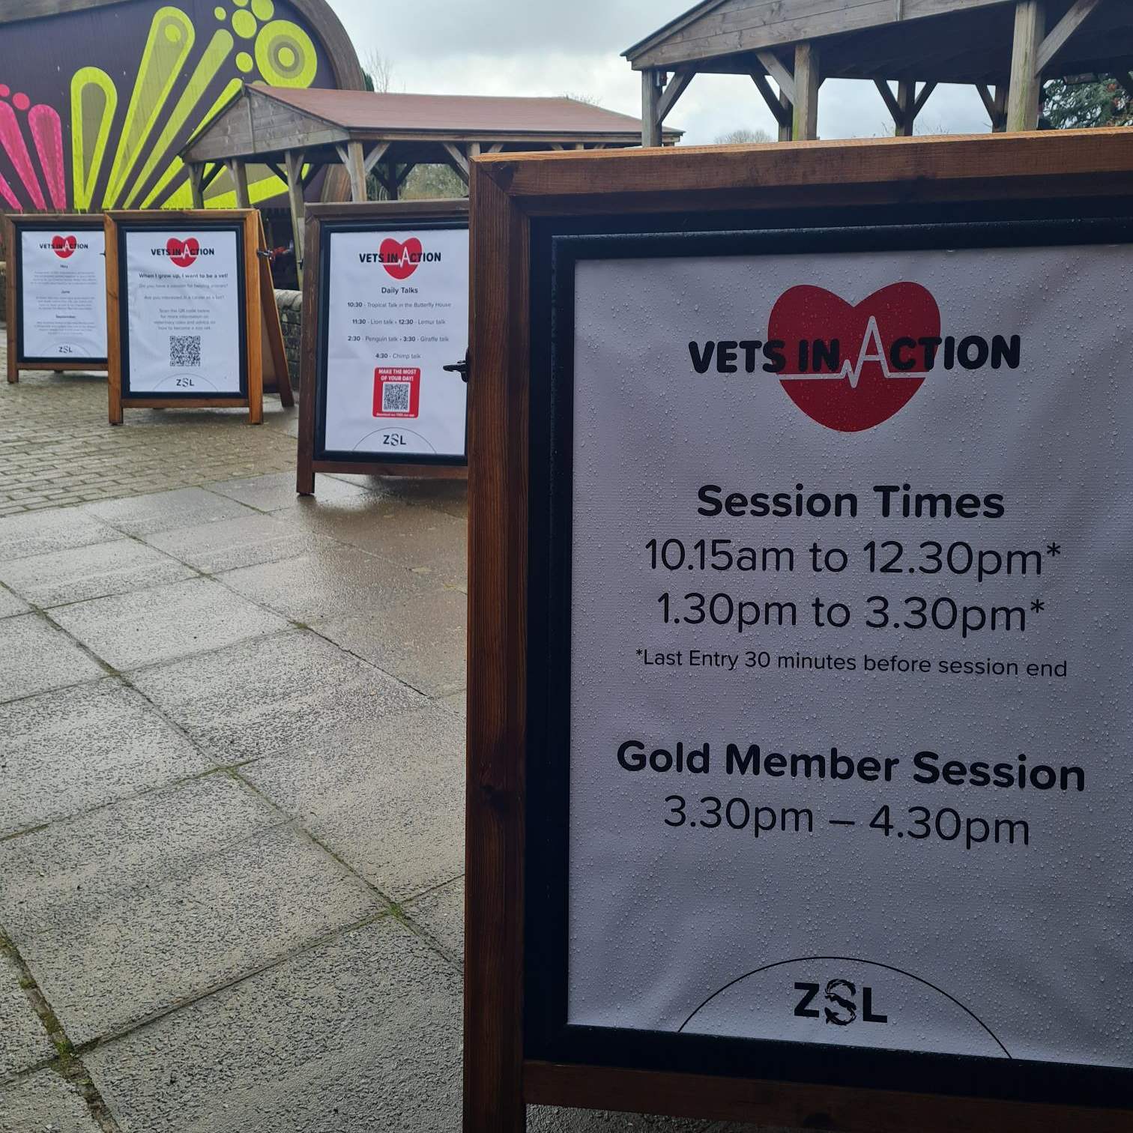
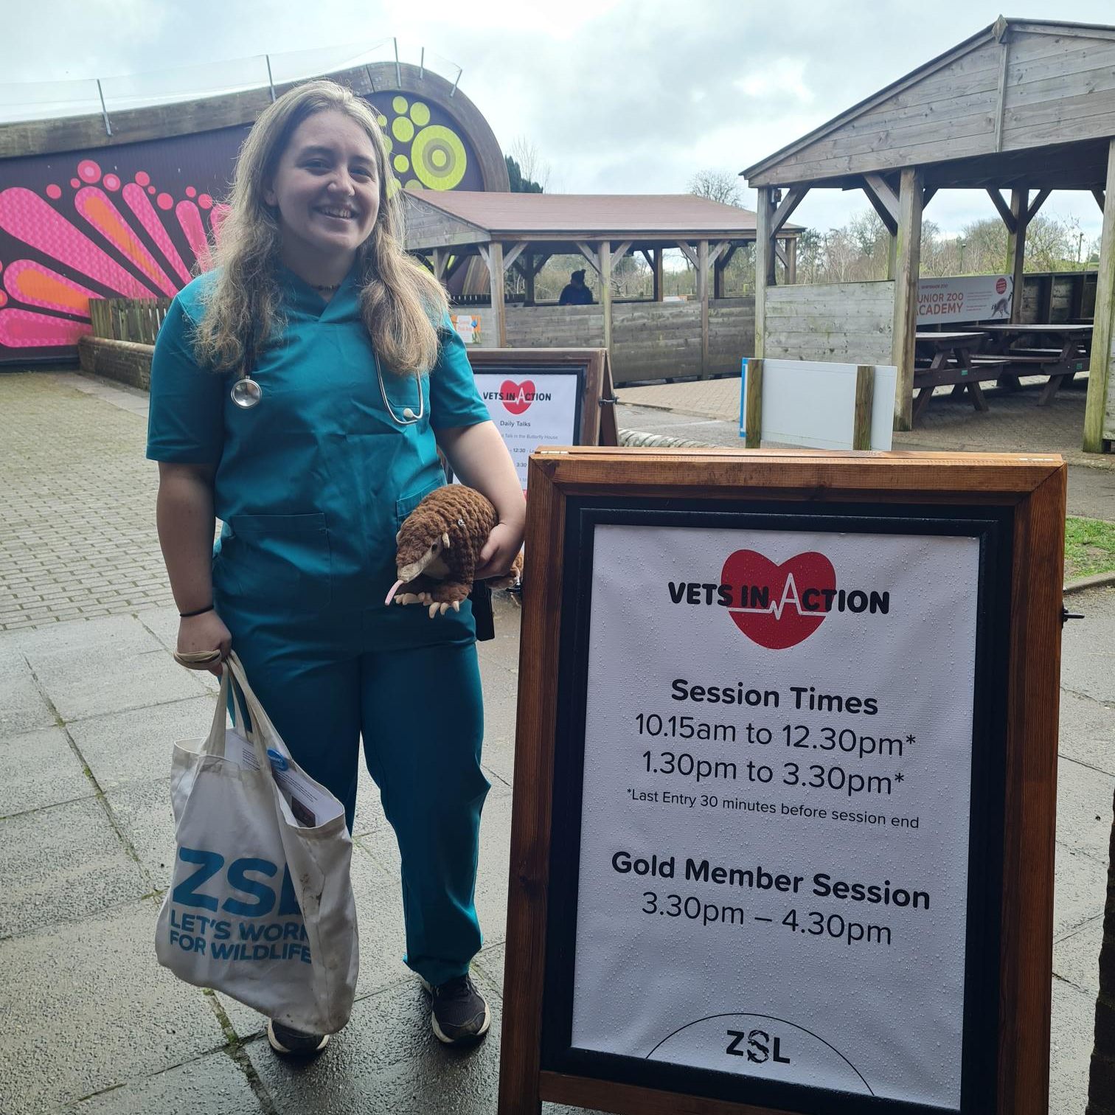
While you wait
There may be a queue before you enter the event.
Time slots are opened every 15 minutes.
There is signage to read about our daily talks and some veterinary stories from the zoo in 2024.
A volunteer vet may be outside with some games which you can play if you would like to.
A Penguin Queue Hopper Pass can be used if needed.

Slide 5
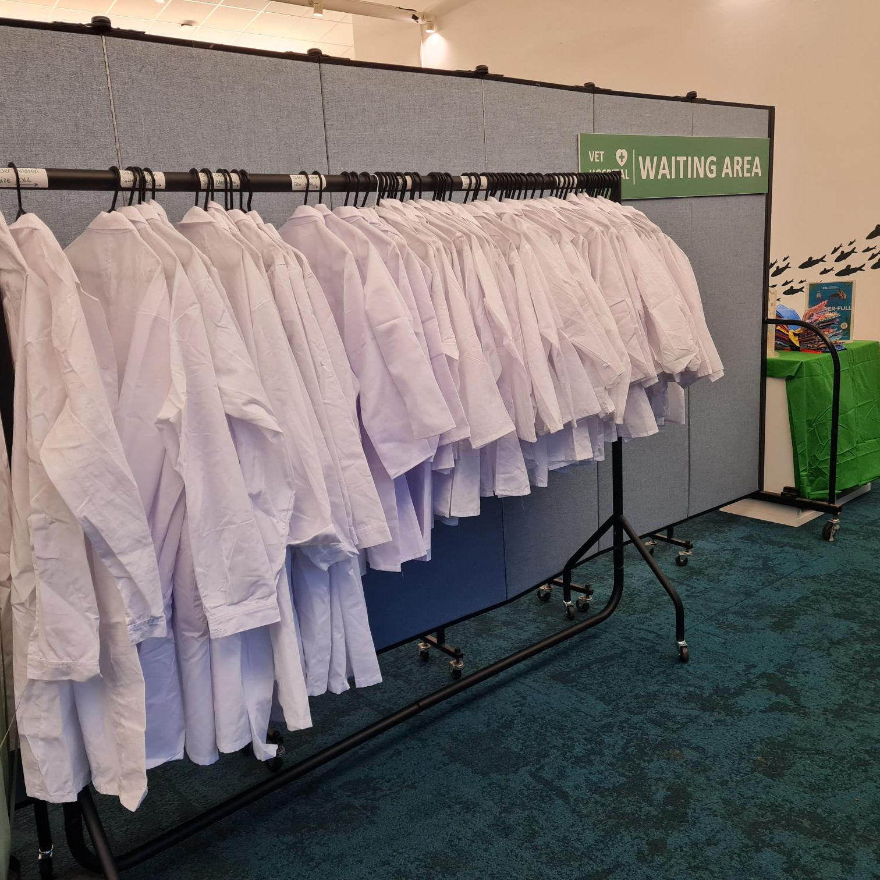
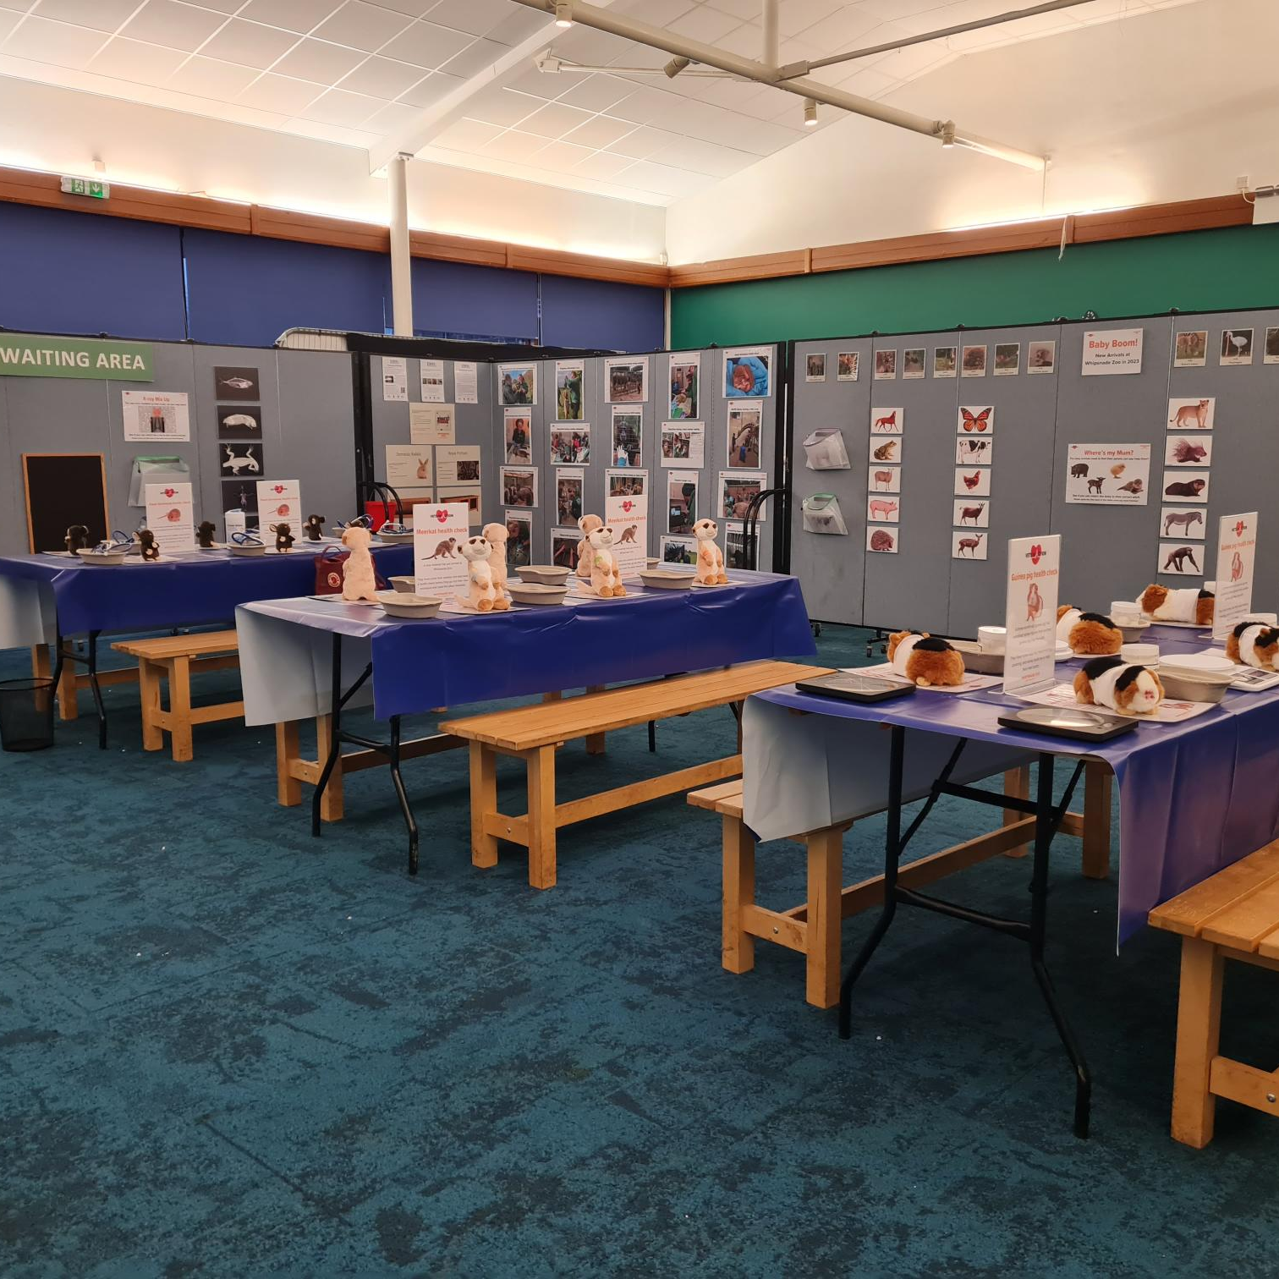
In the Vet Training Room
You will be greeted by one our vets who will explain what to do.
You can dress up in a lab coat if you would like.
You will spend around 15 minutes in this space.
In the ‘vet training’ room you can help our soft toy animals and use toy equipment to treat them like a vet would or play our puzzle games around the room.
You will be called through to one of our Vet clinic or our Vet Airport when it is time for your turn.

Slide 6
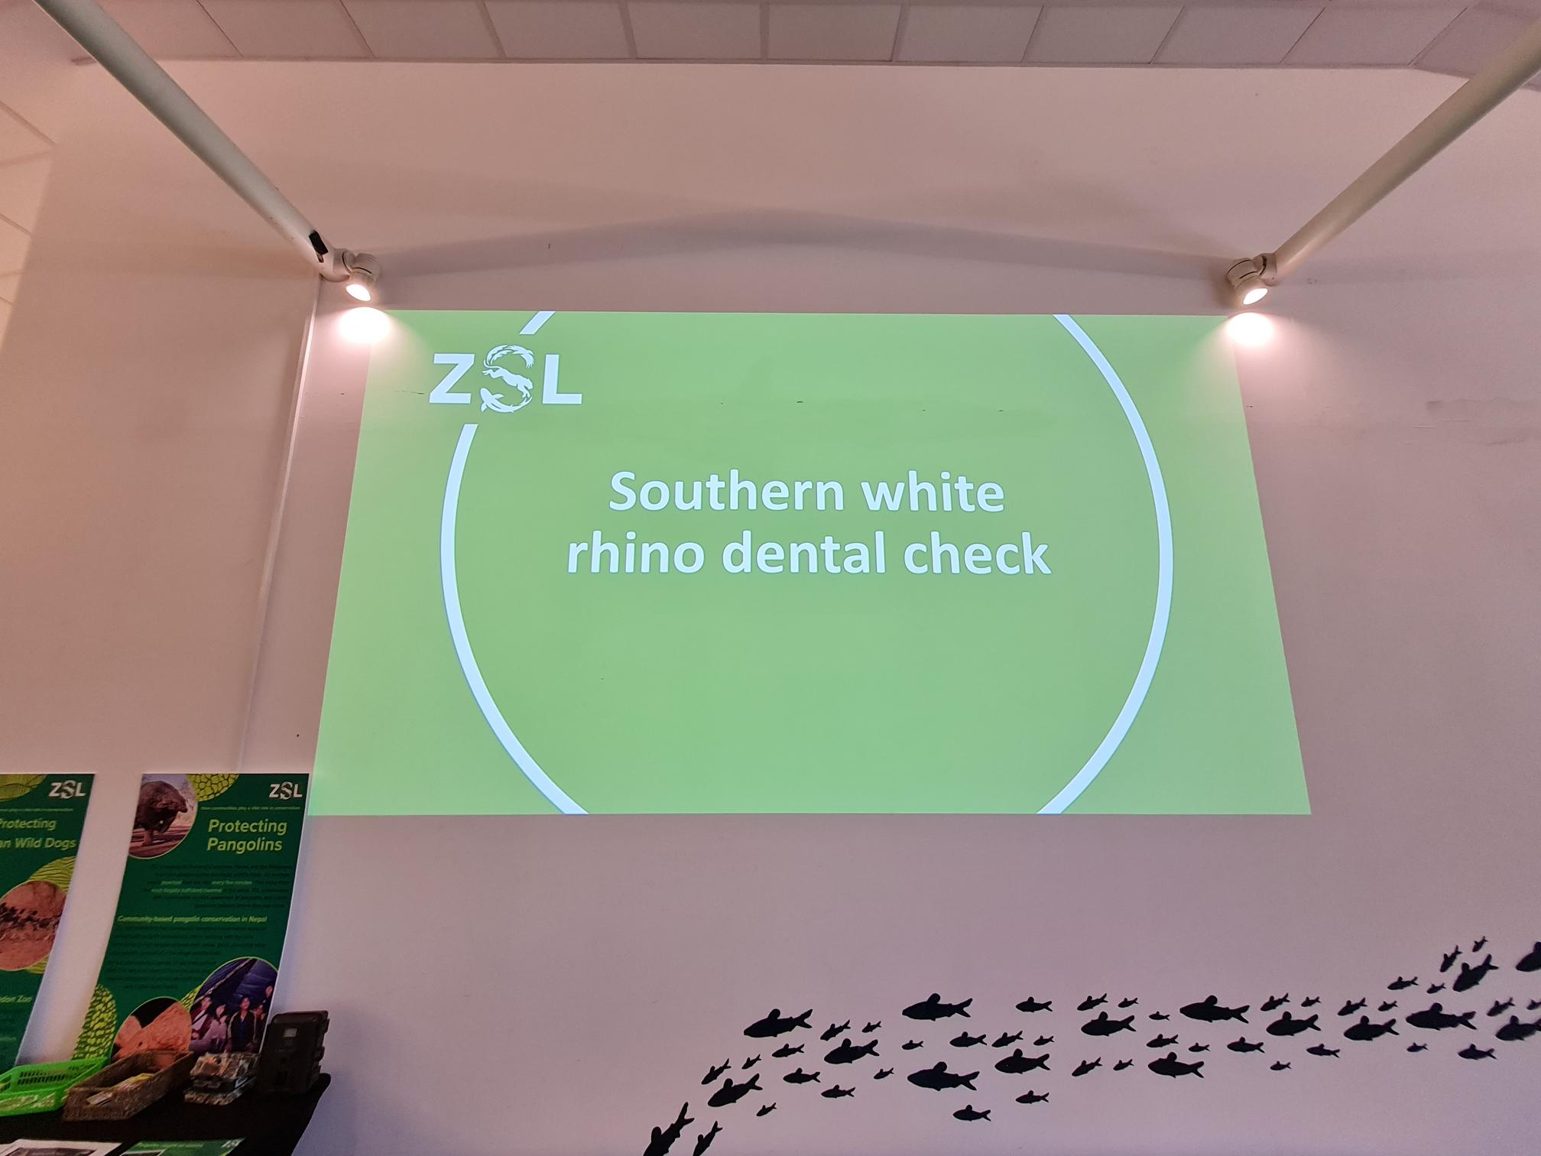
What you might hear
There will be a video playing in the event space.
It is 7 minutes and 30 seconds long.
It is played at low volume and is on a continuous loop.
There will be other families in the room with you so it may be noisy at times.
There are ear defenders available if you would like them. Please ask one of our friendly vets if you need a pair.

Slide 7
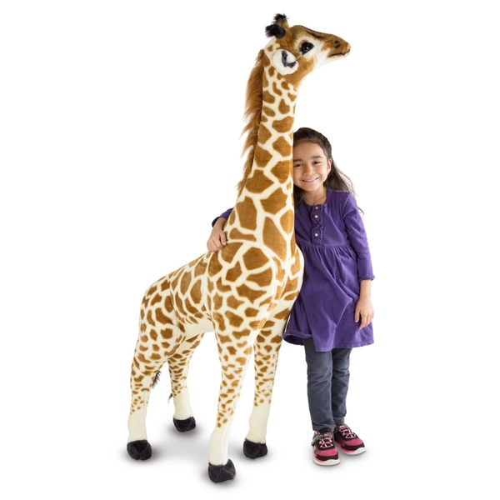
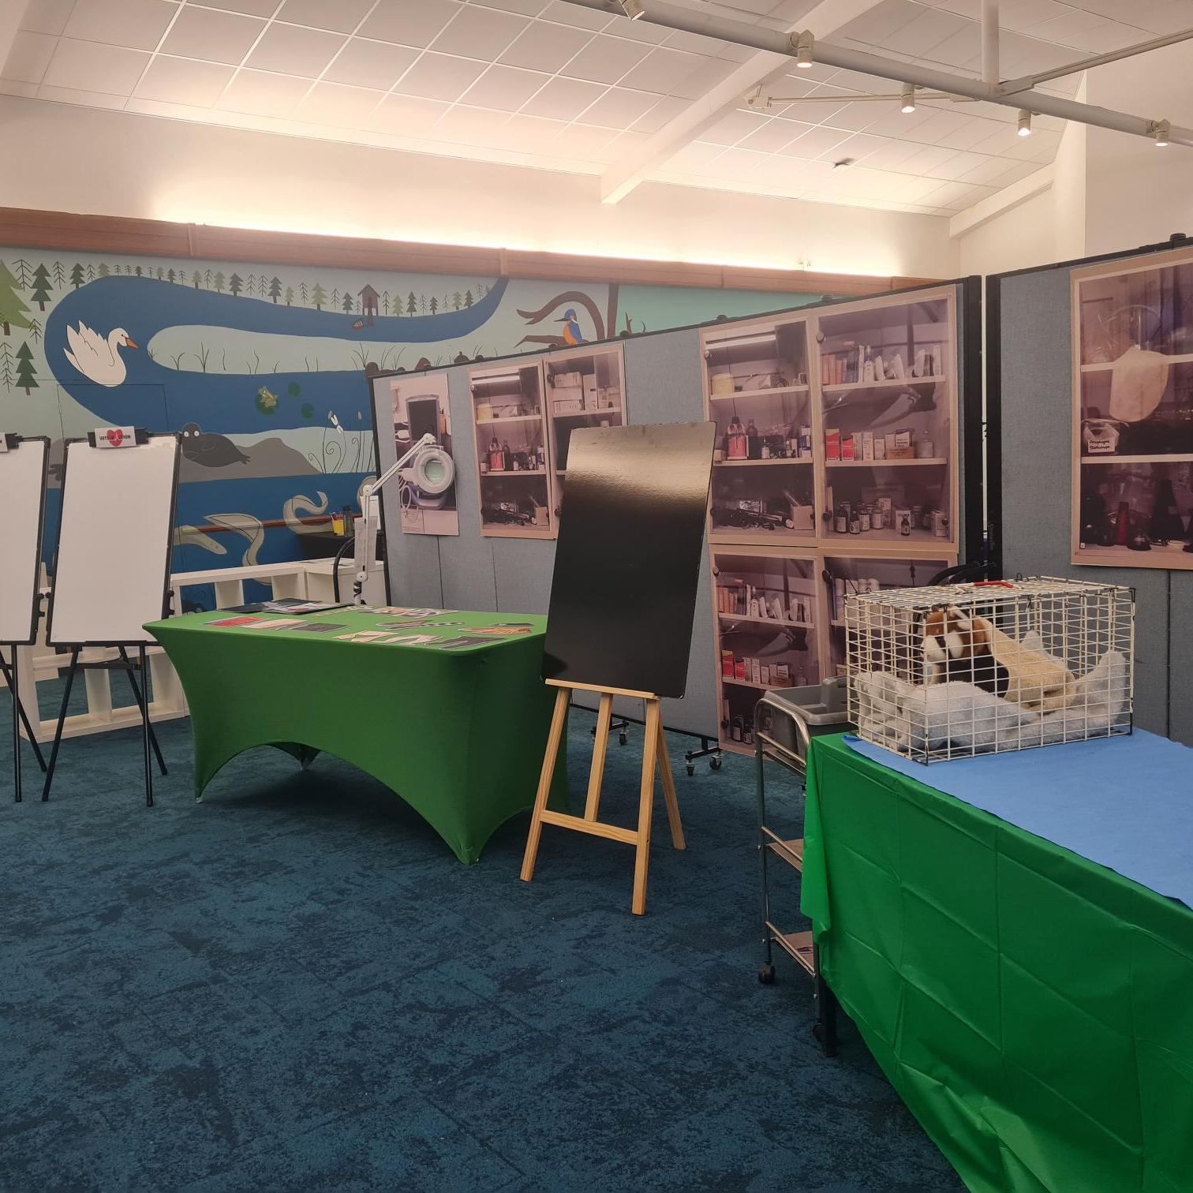
In the Vet Clinic
Suitable for under 7’s, our vet clinic is ready for you to help us with a giraffe health check.
This interactive scenario lasts around 10 minutes, and you can choose to take part or simply sit back and watch.
You will learn all about what makes a giraffe special and have a chance to participate in their health check if you would like to. The scenario involves a 5ft tall cuddly toy giraffe, pictured here for scale
Giraffe photo from www.smythstoys.com

Slide 8
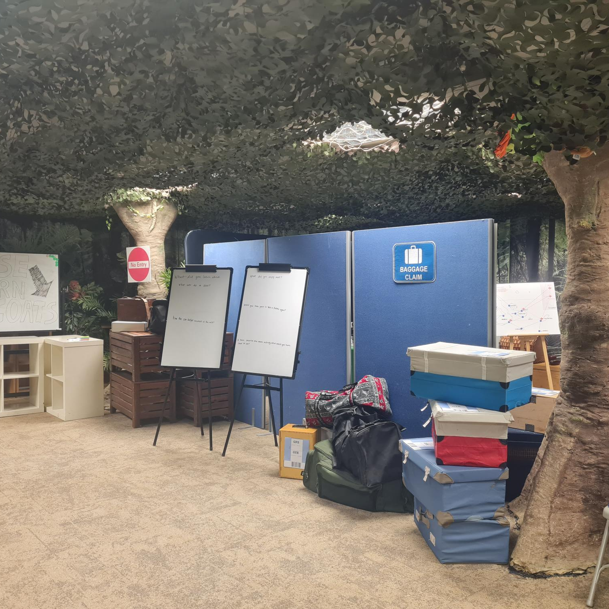
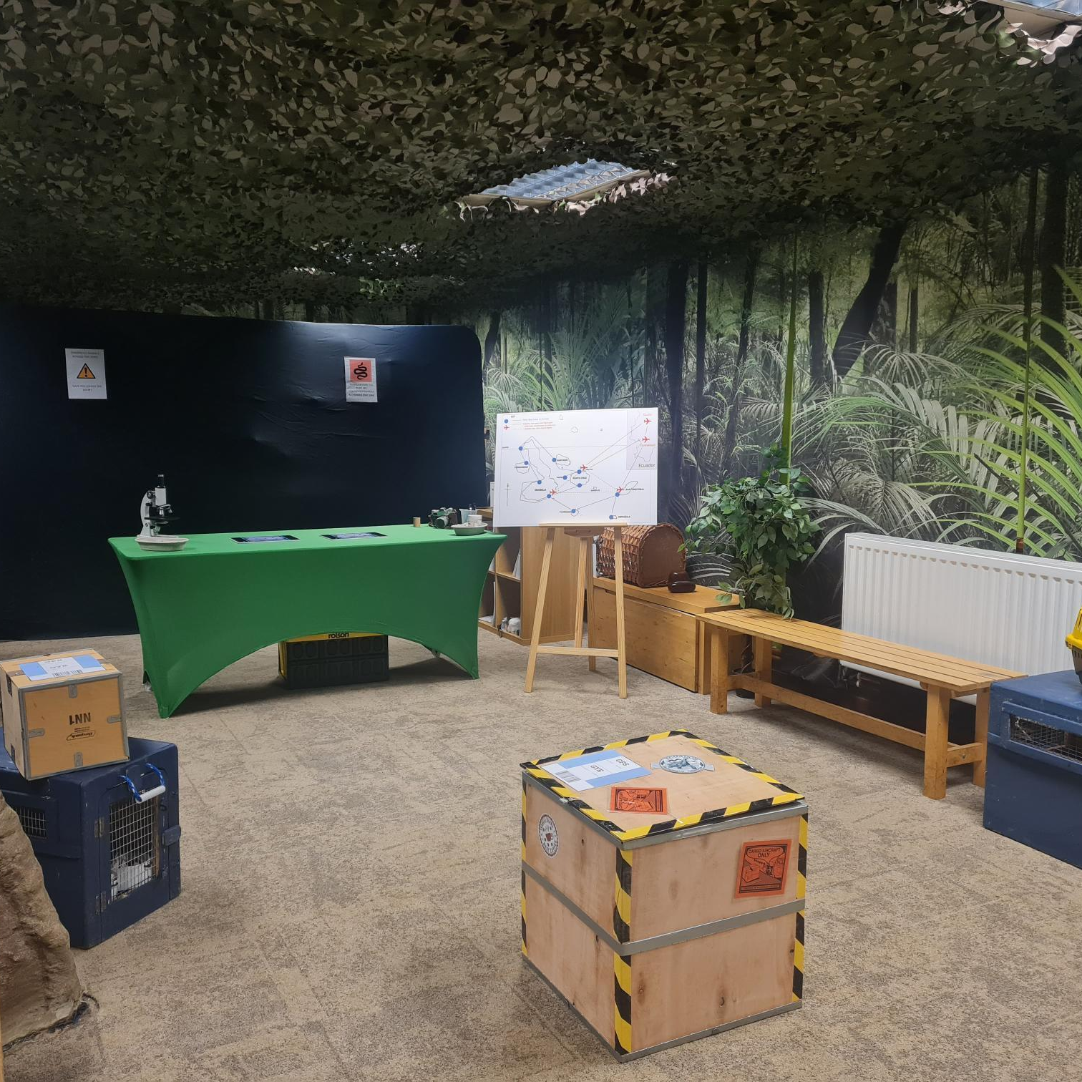
In the Airport
Suitable for over 7’s, our customs office at an airport is ready for you to investigate wildlife crime.
This interactive scenario lasts around 10 minutes, and you can choose to take part or simply sit back and watch.
You will learn all about illegal wildlife trafficking and help our vet to health check some animals if you would like to.

Slide 9
FAQ’s
Is the event included in my ticket price?
Yes, the event is free for all visitors.
Are there any real animals used in the event?
There are no real animals used in the event. Soft, plush toy animal are used in most activities for visitors to interact with. The over 7s activity (In the Airport) uses 3D printed animals.
How do I gain access to the relaxed opening?
Visitors who wish to access this should download a Penguin pass queue hopper here: Accessibility | Whipsnade Zoo
Ear defenders will also be available to borrow throughout the event.
How long will I be in the event?
The event activities will last around 25 minutes. You will have time to access the self-led activities before moving on to a vet scenario.
Can I re-enter the event during the day?
You may re-enter at any point during the day within the timed sessions advertised. Please note we are expecting a large amount of visitors so there may be a wait time before you can enter the event.

